Slide 1
Diseases
Communicable
Vs.
Non-Communicable

Slide 2
2 Types:
Infectious/Communicable Diseases- Diseases that are caused by living organisms; Can be passed from person to person, animal or object.
VS.
Non-Communicable/*Lifestyle Diseases- Diseases that Cannot be passed from person to person. More likely caused by neglect of the body or other factors.

Slide 3

Examples of Communicable Diseases
1. Common cold
2. Hepatitis A-C
3. Chicken Pox
4. SARS
5. Flu
6. Mumps
7. Malaria
8. Herpes
9. STD
10. Measles
11. Lymes Disease

Slide 4
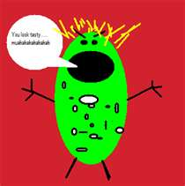
Pathogens
PATHOGENS – What causes the disease:
Viruses (genetic material that invades cells & multiplies – ie. cold, flu)
Bacteria (single celled organisms * like warm, dark moist environment – strep, e-coli,
Fungi (Examples: mushrooms, mold / mildew- live in air, soil, plants & water) Can produce infections in lungs or on skin…athletes foot, yeast infections )
Protozoa (* Parasitic diseases-microscopic animals; amebas…(ie.*Giardia –infection of the sm. intestine*Malaria- tropical areas /from mosquitoes/ fever .Trichomoniasis-STI).
Host- The infected person

Slide 5

Immune System: What does it do?
The immune system is a combination of body defenses made up of cells, tissues and organs that fight off germs…
Immunity – Body’s ability to resist germs that cause a certain disease.
Antibodies – Proteins produced to fight a particular antigen
(substances that send the immune system into action.)
Lymphocytes – Special white blood cells that attack germs and kill them off.
Vaccines – Preparation of killed or weakened germs injected into the body to produce antibodies.

Slide 6
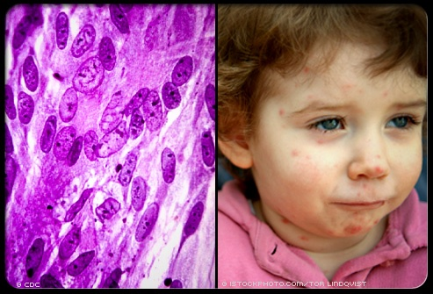
The Immune System: Body’s First line of Defense:
Tears, Mucus & Saliva
Skin
Cilia
Stomach Acids
Urine
Friendly Bacteria
White blood cells (Neutrophils)

Slide 7
Examples of Non-Communicable or
Lifestyle Diseases
Diabetes
  Type 1
  Type 2
  Gestational
Cardiovascular Disease
Cancer (Skin, Colon, Breast, Testicular, etc.)
  Self Examinations!!
Stroke
Hypertension (high blood pressure)
Heart Attack
Emphysema
Obesity

Slide 8
Non-Communicable Disease Causes
Uncontrollable:
Controllable (choices)
Genetics
Family History
Age
Gender
Race
Environment
Diet/Exercise
Lifestyle Behaviors
Weight
Blood Pressure
Tobacco/Alcohol/Drug Use
Stress Levels
Environment

Slide 9

3 main Causes Of Lifestyle Diseases
Choices -(Controllable Factors in your life)
Heredity – (Know your family history *Early diagnosis)
Environment – (Avoid unhealthy-Pollution, Mold, Smoke etc.!)
Prevention:
-Diet -(low in saturated fat, high in fiber/fruits & veggies + fish oil )
-Exercise - (3-4 x a week, moderate to high intensity)
-Weight - a BMI of 30 or higher is considered unhealthy☹

Slide 10
What can we do to prevent disease?
Wash hands often
Cover nose and mouth when you cough or sneeze
3. Don’t share eating utensils, drinking glasses or food
Avoid bites from ticks and mosquitoes
5. Get necessary vaccinations
6. Avoid contact with people who are sick
Food-borne illness- Keep hot food hot (+140), keep cold food cold(-40). Keep the kitchen/utensils clean☺
Get medical care when sick (antibiotics-when needed)

